Slide 1
SOA SERVICES – Action on payments
Technical - Overview
Integration Team
July 2017

Slide 2
AGENDA
Overview
Types of Services
Samples

Slide 3
“
GPP processes and manages payments. To be able to handle payments outside of GPP, there are various SOA services provided those can be invoked from external sources”
GPP SOA Guide Action On Payments

Slide 4
FNDT Message in Payment Flow
GPP
File Interface
WS Interface - Action
WS Interface - List
MQ Interface
WS Interface - Load
UI Interface
DB

Slide 5

Services
QueueListService - Provides a list of payments which meet a given selection criteria and are filtered by user restrictions
MessageLoadService - Loads a specific payment, i.e. the third party application gets all payment details
MessageSubmitService - Takes a manual action on a specific payment, such as Submit or Cancel
Requests are processed immediately and response is given back.
Additionally it returns processing status as successful/failure.
These services are exposed as Web Services over SOAP and they are based a Service-Oriented Architecture (SOA). This enables 3rd party applications to interact with GPP.

Slide 6
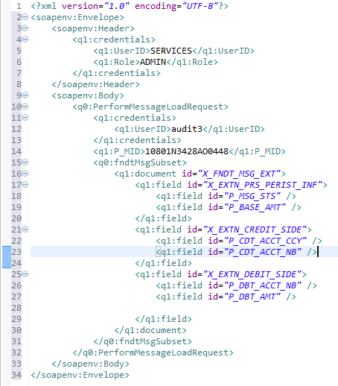
Messageloadservice- example
User and Role
Payment to Load
Fields to Load

Slide 7
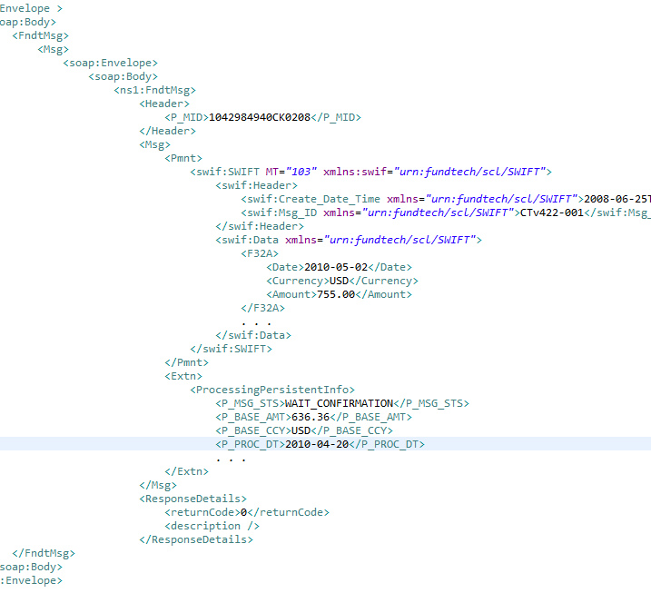
Messageloadservice- response
Payment Fields
Extension Fields
Response Code

Slide 8
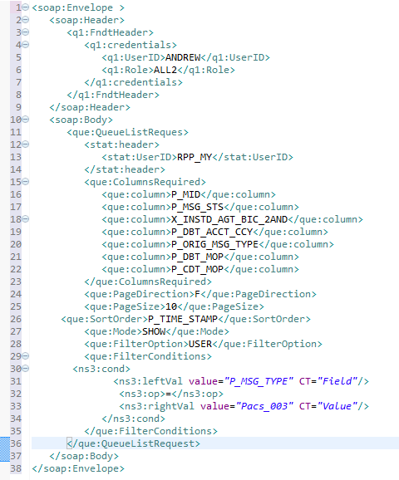
queuelistservice - example
message header
The illustration shows how payment list can be retrieved using server.
Response field list
Sorting/Paging Preferences
List condition

Slide 9
queuelistservice - Response
message header
Response field list
Sorting/Paging Preferences
List condition

Slide 10
Messagesubmitservice - example
Performs various activities.
Submit – Submits new payment for processing
Action - Takes a manual action on a specific payment, such as Cancel, Approve, Reject and Repair etc.
Similar to Button press function.
Accepts partial payment for amendment.

Slide 11
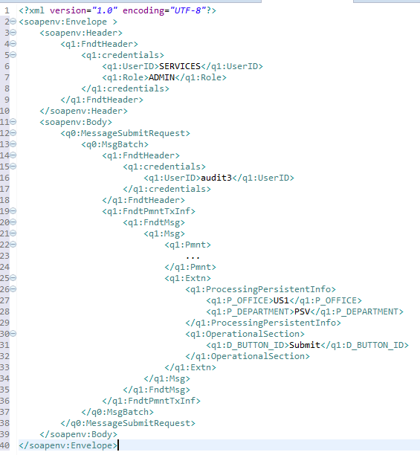
Messagesubmitservice - example
message header
Actual Payment
Additional Info
Action

Slide 12
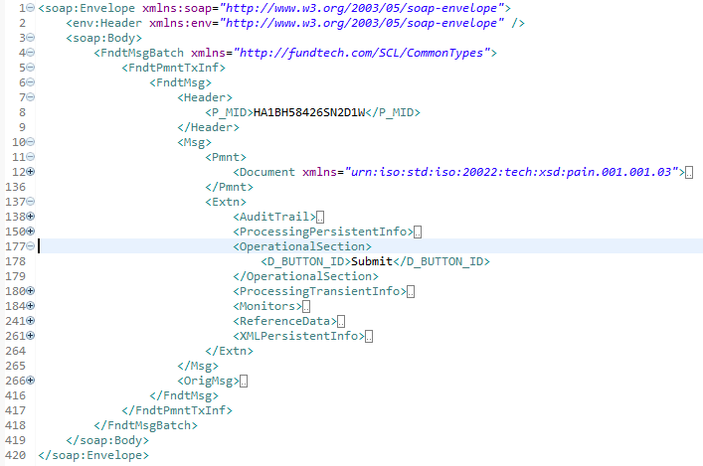
Messagesubmitservice - response
Payment ID
Current Payment
Additional Payment Info
Original Payment

Slide 13
Possible actions
Description | Button Id
Performs validations and processes the payment either for a new message created via the service, or after update of an existing message. Returns all errors or a successful response | Submit
Prompts a rejection (PACS 002) for a payment | Reject
Returns all errors, and optionally additional computed, derived and enriched information, without saving the payment | Validate
Prefix used if there is more than one way to receive specific data. Example: OX_CDTR_AGT_BIC_1OR or OX_CDTR_AGT_BIC_2AND. GPP copies the data into OC_CDTR_AGT_BIC to facilitate determining whether creditor agent BIC was provided or not. Relevant only for originally received attributes. | Approve
Sends the payment to Repair status | Send to Repair
Saves payment without performing validation (set payment status to Timed Hold) | Save
Confirms the payment is not a duplicate for payments that are waiting in possible duplicate queue | AcceptDupex
Initiates the cancellation process. That is, changing message status to Pending cancellation request from which a user can either RefuseCancel or Cancel the payment. | Cancel Request

Slide 14
Thank you
Rajesh Badiye
Integration Team
Rajesh.badiye@finastra.com

